Slide 1

Let The Digits Speak
Team Members:
1)Bhavika Gaichare
2)Gaurav Mevada
3)Ruchita Patil
4)Nikita More

Slide 2
Problem Statement:
Customer behaviour is an important factor for any business.
In banking sector customer retention is an important factor in order to improve financial performance of the bank. On the basis of customer behaviour banks can provide the suitable products to ensure customer satisfaction.
Bank collects customers information for various reasons, one of them could be to cross-sell different products to the same customer.
Here in the given dataset CMB Bank wants to understand how the credit card usage will impact the business.

Slide 3
Table of Contents:
EDA
Visualization
Feature Engineering
Feature Selection
Model Building
Inference

Slide 4
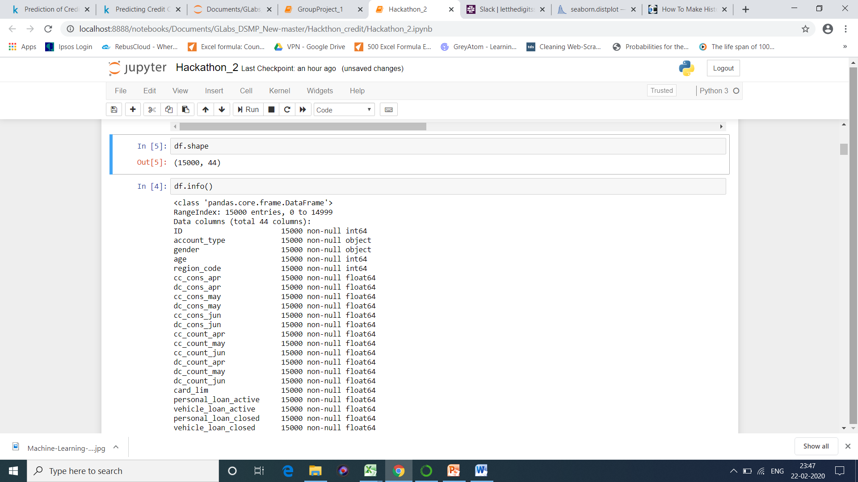
EDA & Visualization
Question 1) What is the strength of the dataset?
Readings: From a given Dataset we could see there are total 15000 cases and 44 Features.

Slide 5
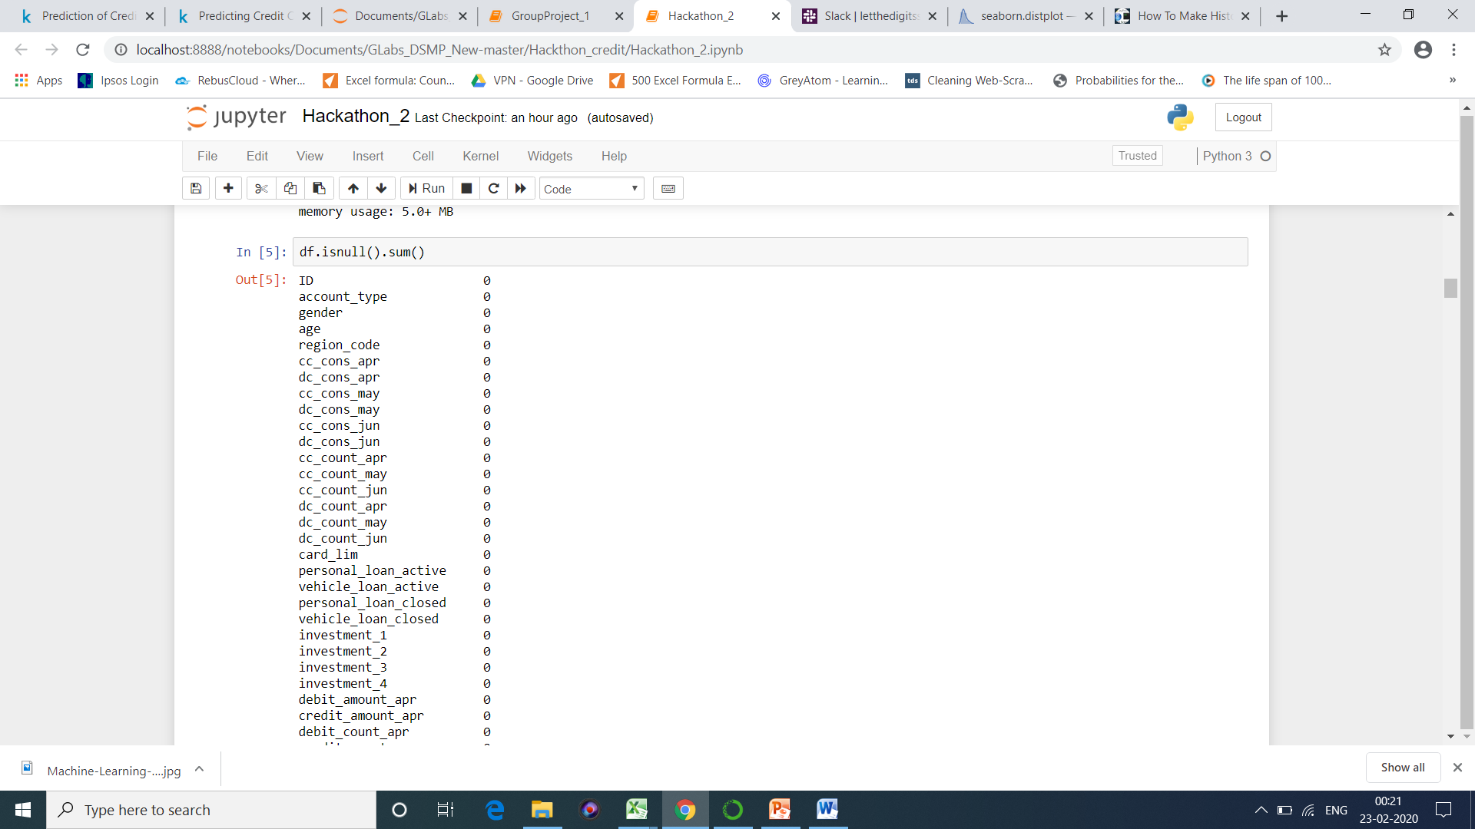
Question 2) Are there any data discrepancies? If they are what should be our approach to handle them?
Readings: We observed that there were no Null values.
Question 3)What kind of data Science problem is this?
Readings: We can see target variable “Customer credit score “ given in dataset hence this comes under supervised Machine learning!!!!!!
Question 4) How many object and numeric features are there?
Readings: We observe that except Gender and Account Type rest of them are of numeric types. We have also observed that our target labels “Customer credit score “ is of numeric type hence this problem statement comes under linear regression.

Slide 6
Question 5) Are there any feature which are not making sense and we can remove the same from dataset?
Readings: Post going through the entire data, we concluded that few of the feature are not going to help us in analysis and we can remove them. Features to remove were: ‘ID’,'personal_loan_active','vehicle_loan_active','personal_loan_closed','vehicle_loan_closed','loan_enq‘

Slide 7
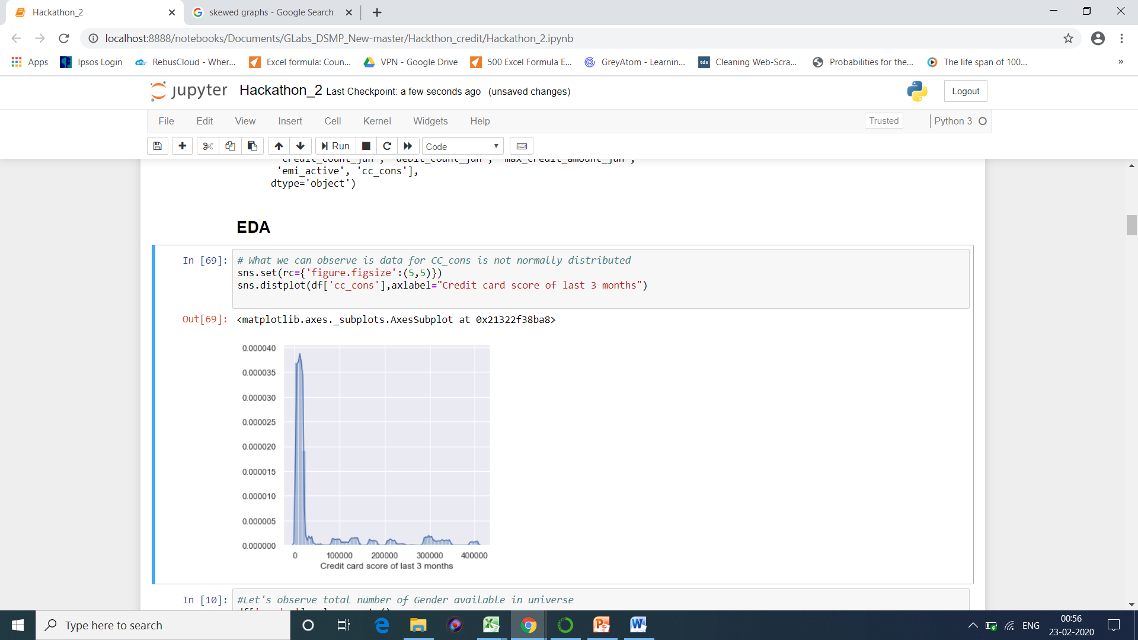
Question 6) Let’s dive in into EDA. What is the nature of the target variable?
Readings: We can clearly observe that data is not normally distributed for target label and it is left skewed. And most of our data does not lie near central tendency.
Hence Gaussian Distribution fails here.

Slide 8
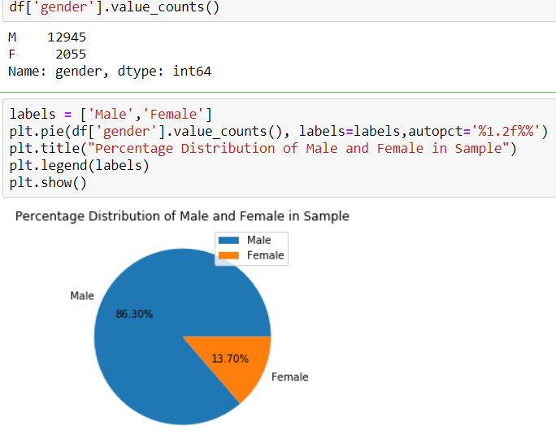
Question 7)What is the Gender spread in sample?
Readings: We can clearly observe most of our customers who are using credit card are Males.

Slide 9
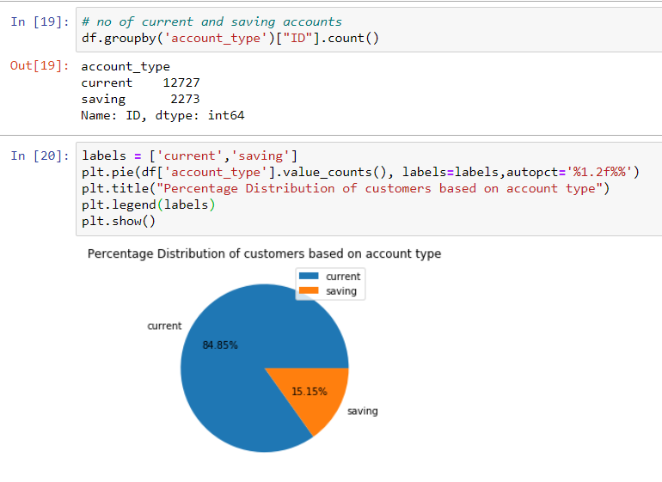
Question 8) What is the total number of people having current or saving account?
Inference: Here we can see that, around 85 % of accounts are current i.e. they are used for business transactions and rest are saving accounts.

Slide 10
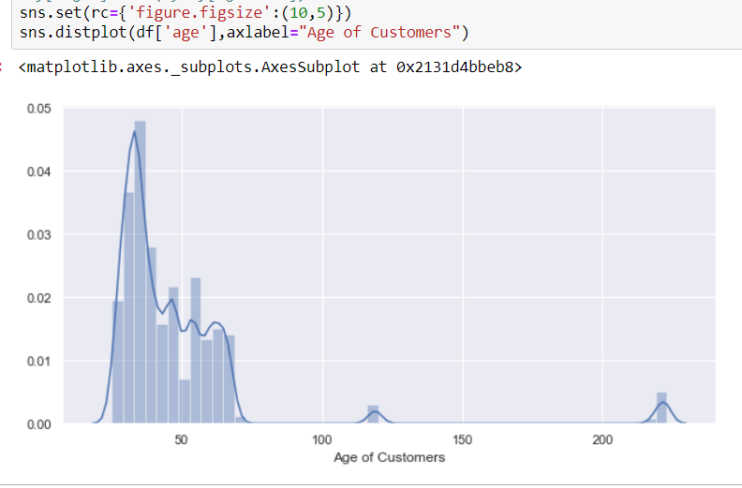
Question 9) Are there any outliers? Are companies giving Credit card to people with Age <18 or >60?
Readings: Our readings shows that data is somewhere close to normal distribution except few of the outliers.

Slide 11
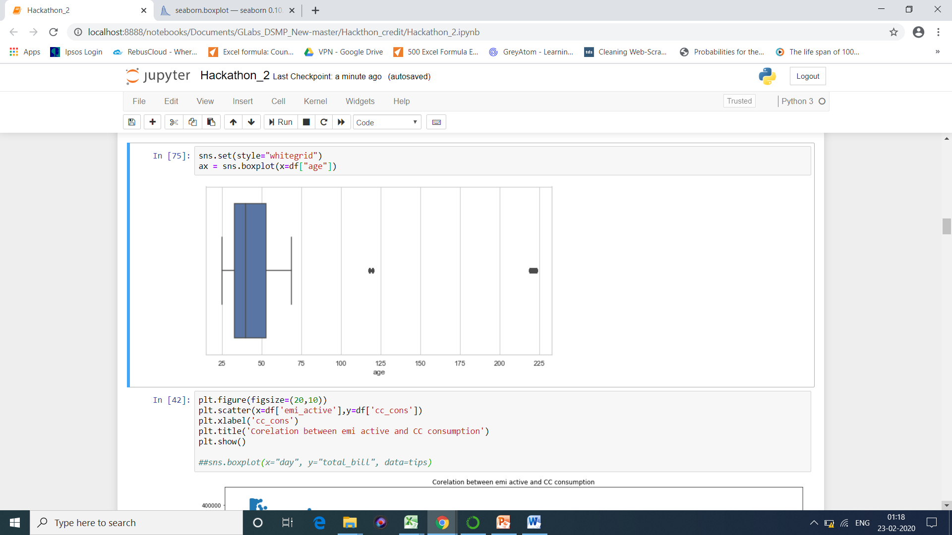
We concluded that only 3.56 % are outlier and which will have no impact on analysis even if we remove them. Hence, we removed the same.
Readings: The Above boxplot shows us 25% of our data is less than 33, 50% of our data is less than 38 and 75 % of data is less than 53.
Person with the minimum Age is: 25
Person with the maximum Age is: 69
Interquartile range is : 20.0
Also, we can see that people with age grater than 60 use credit cards often.

Slide 12
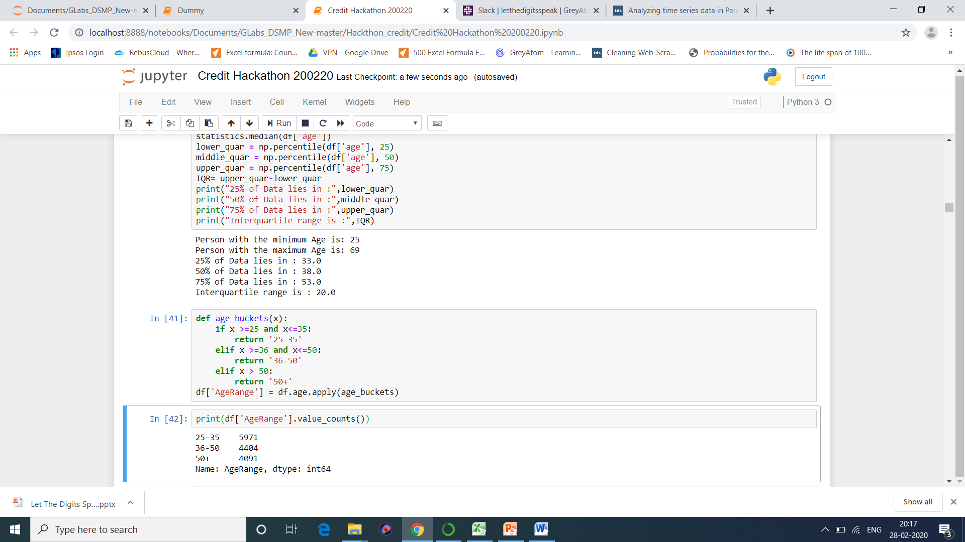
Now , we allotted Numeric Age into Age group codes to make further analysis easy.

Slide 13
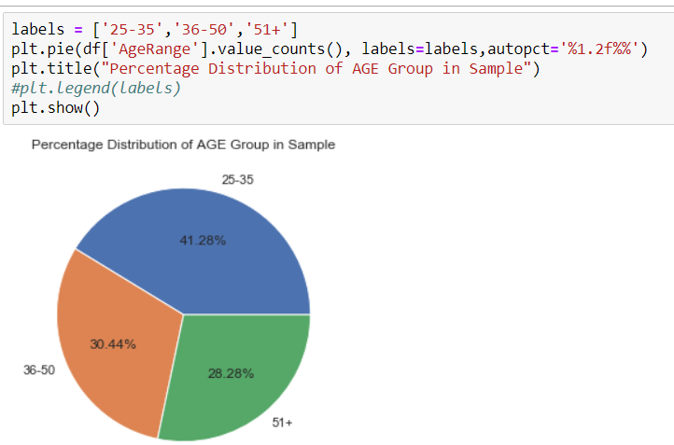
Percentage Distribution of Age In Given Sample:

Slide 14
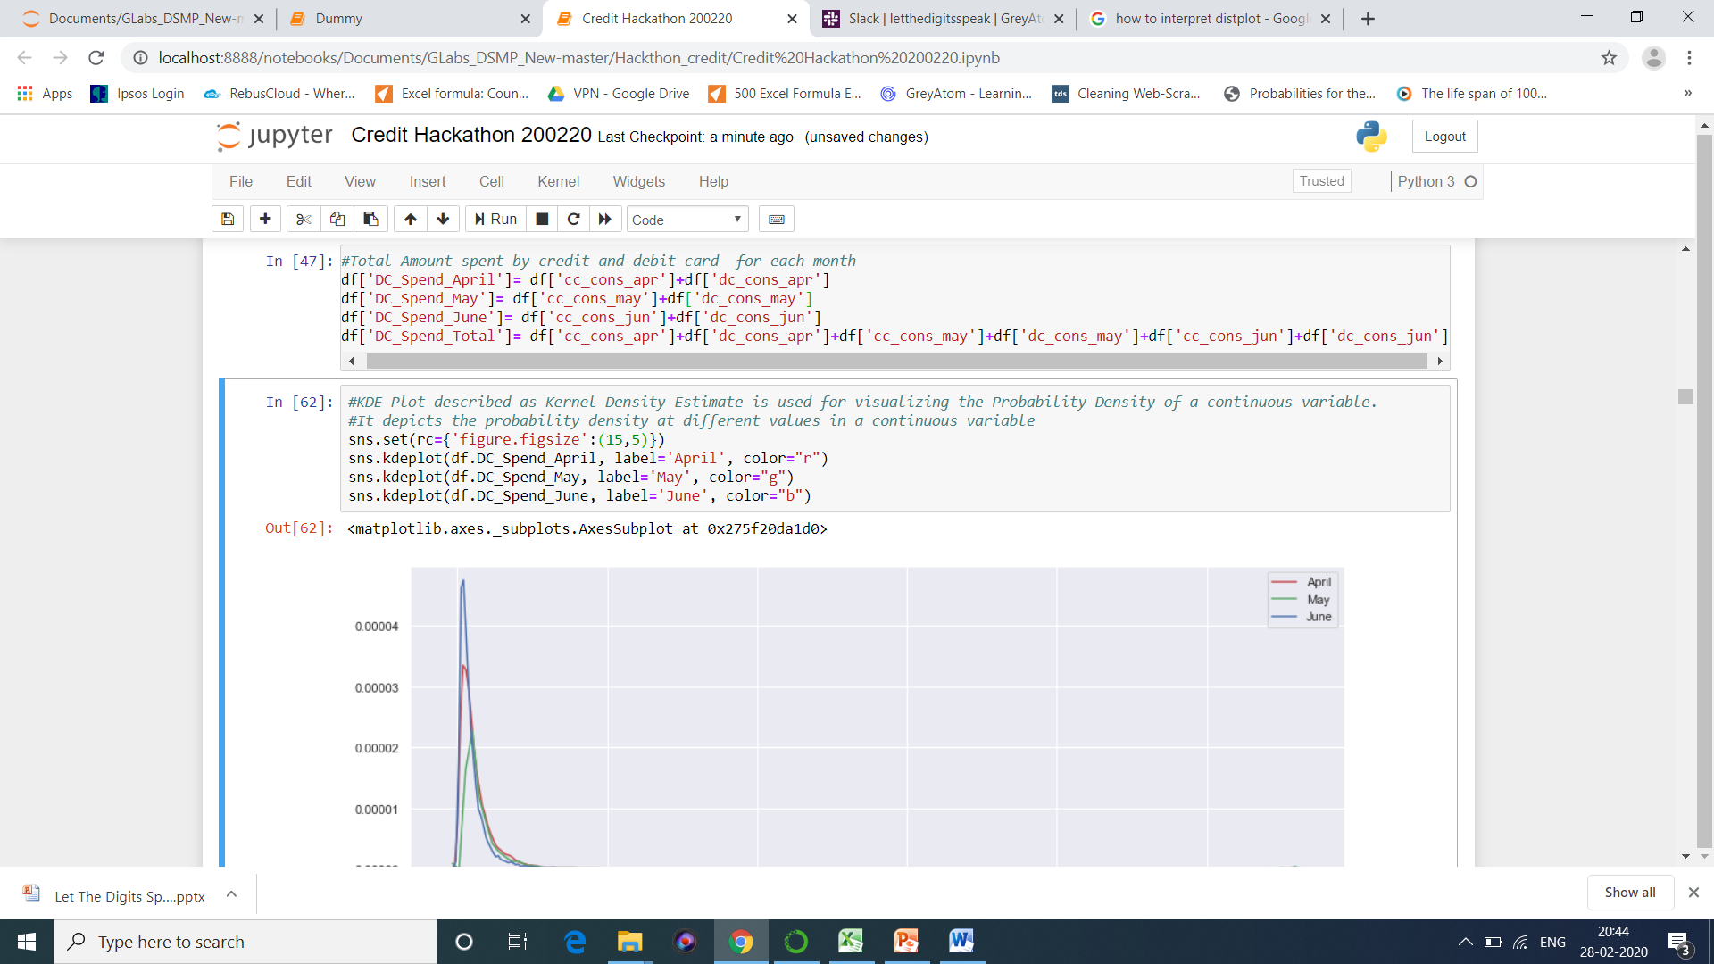
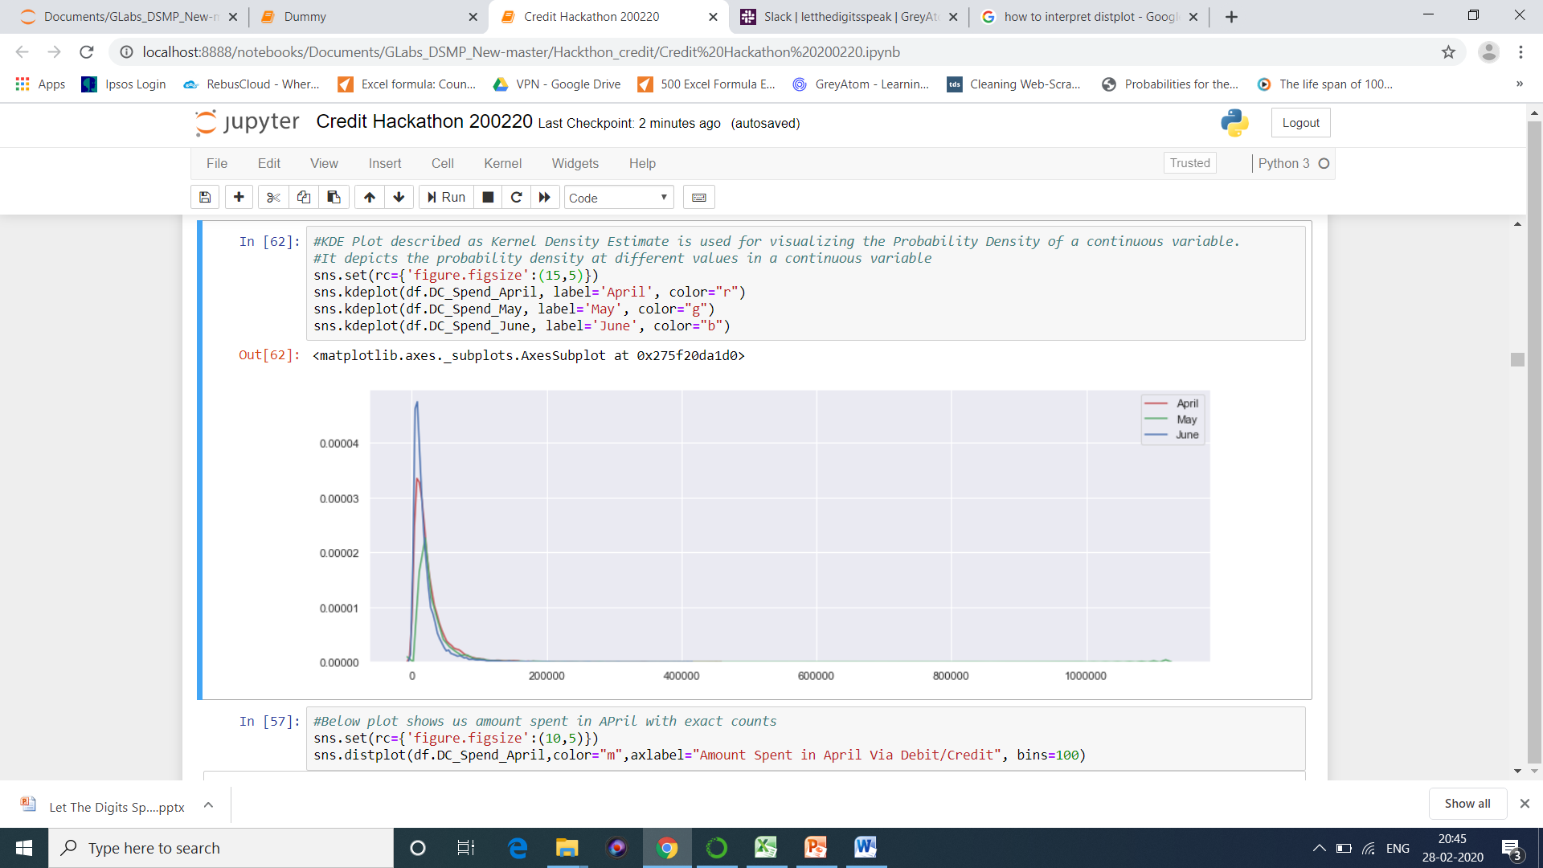
Question 10) What was the total spend of Customer?

Slide 15
Inference: We can clearly see that maximum amount has been spent in the month of April, so this could be due to offers running on credit cards/online shopping websites.

Slide 16
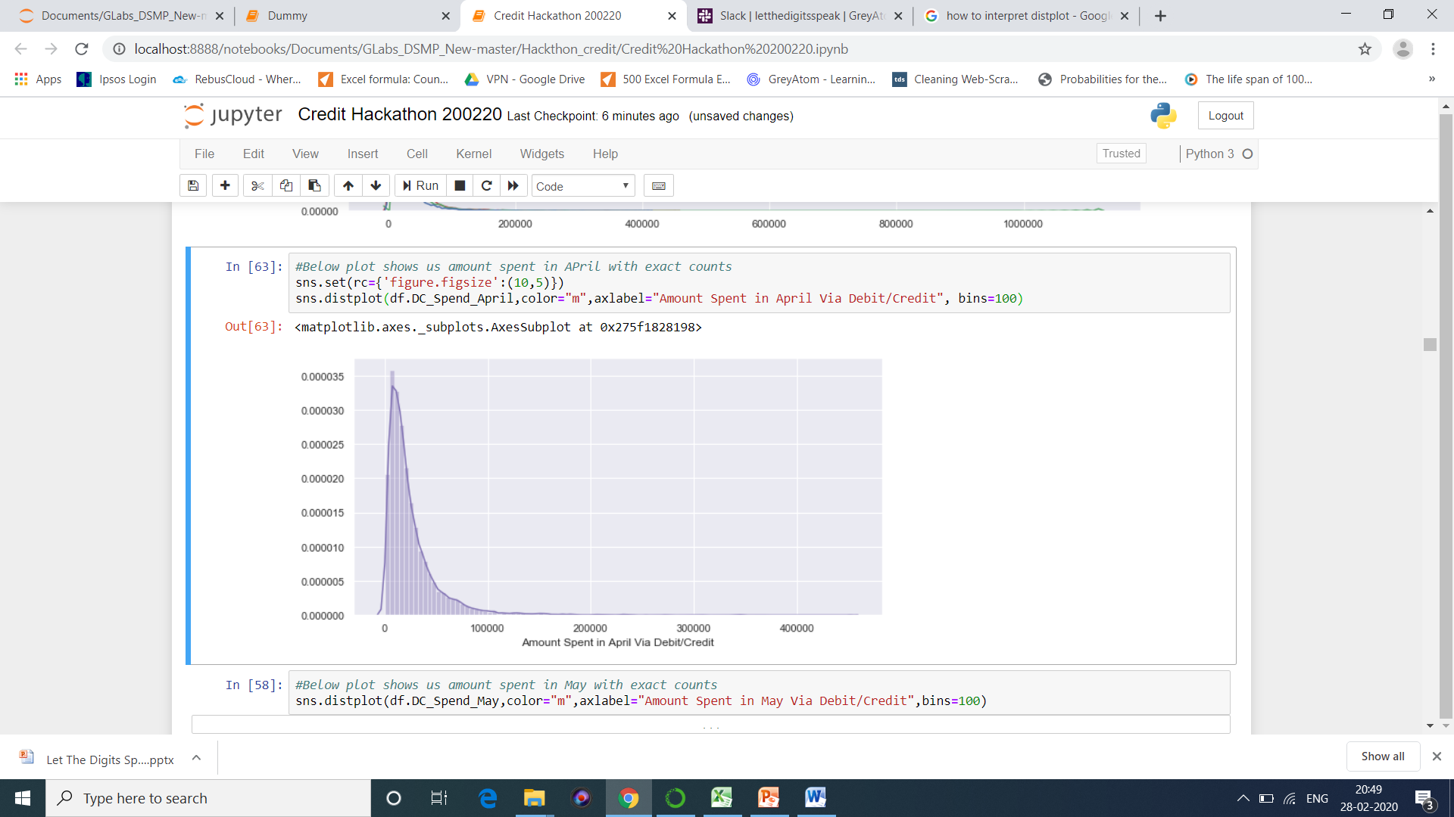
The below graphs are just separated here , the graph in above slide is combined…lets decide together what to keep and what not to.

Slide 17
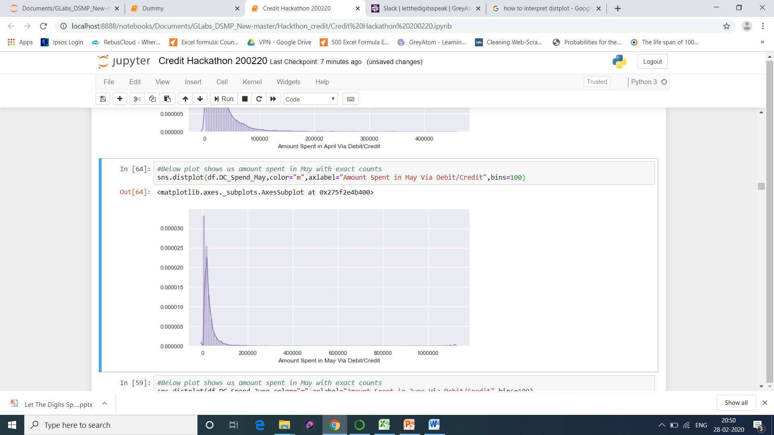
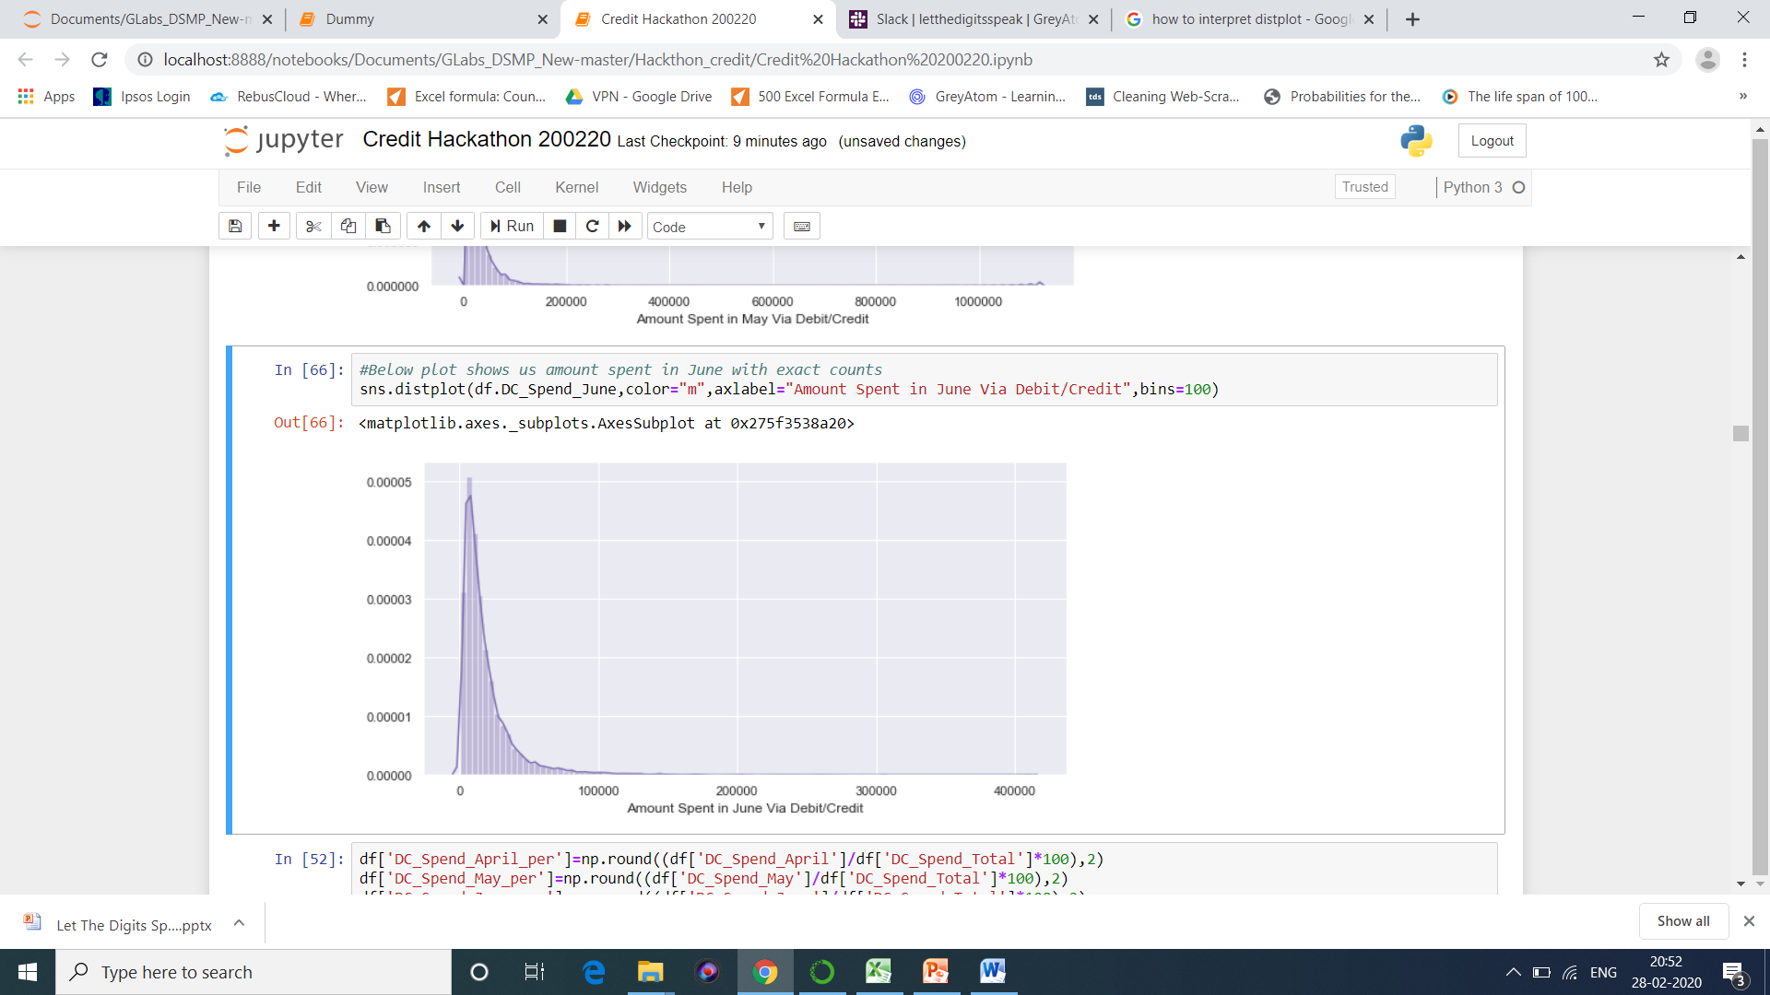

Slide 18
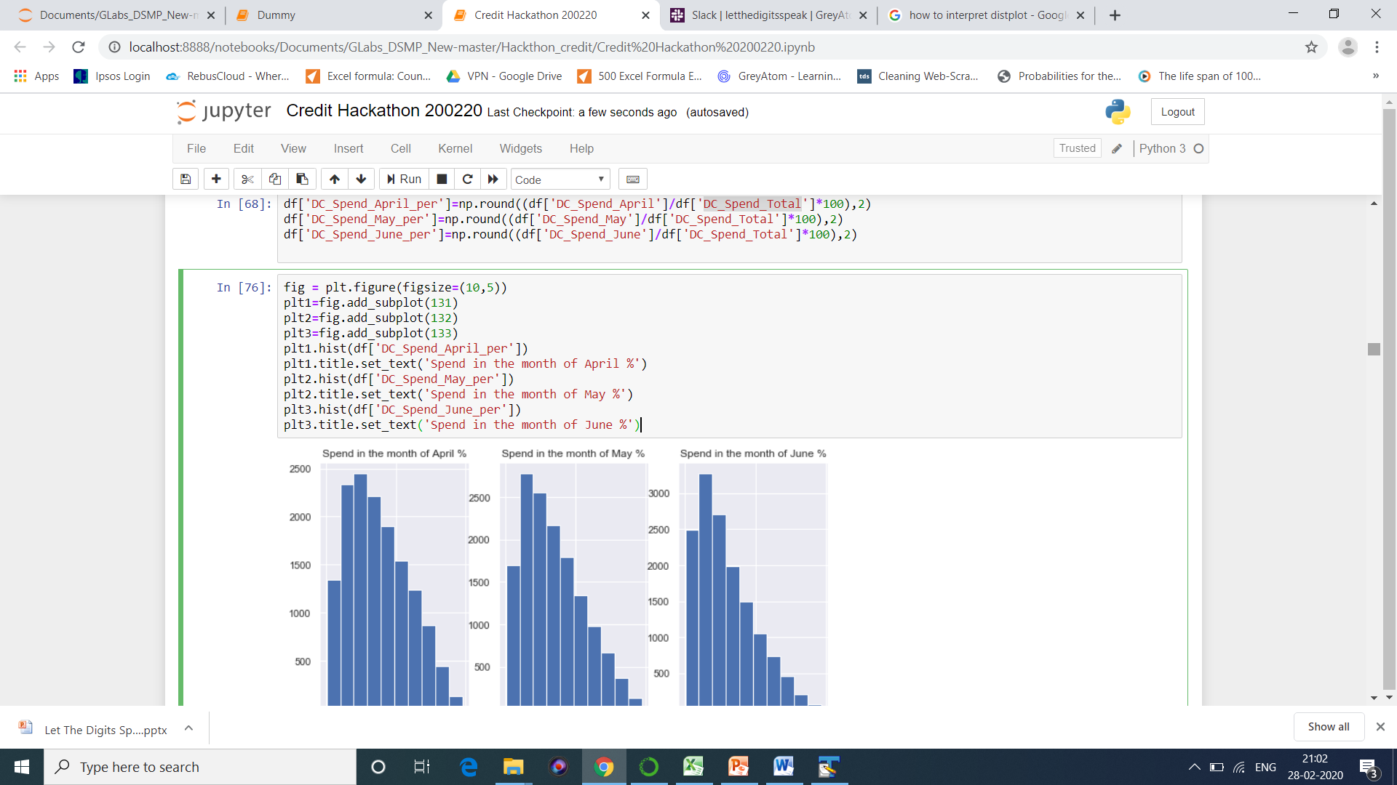
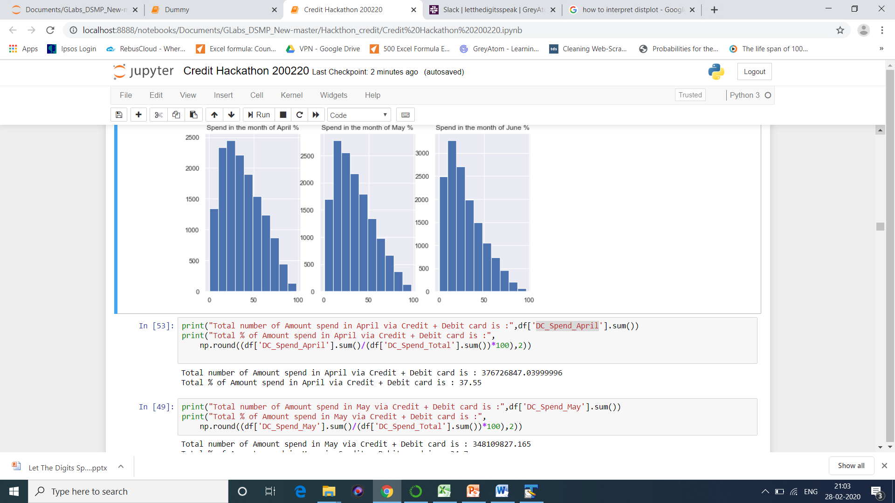
Inference: We can clearly see that maximum amount has been spent in the month of April.

Slide 19
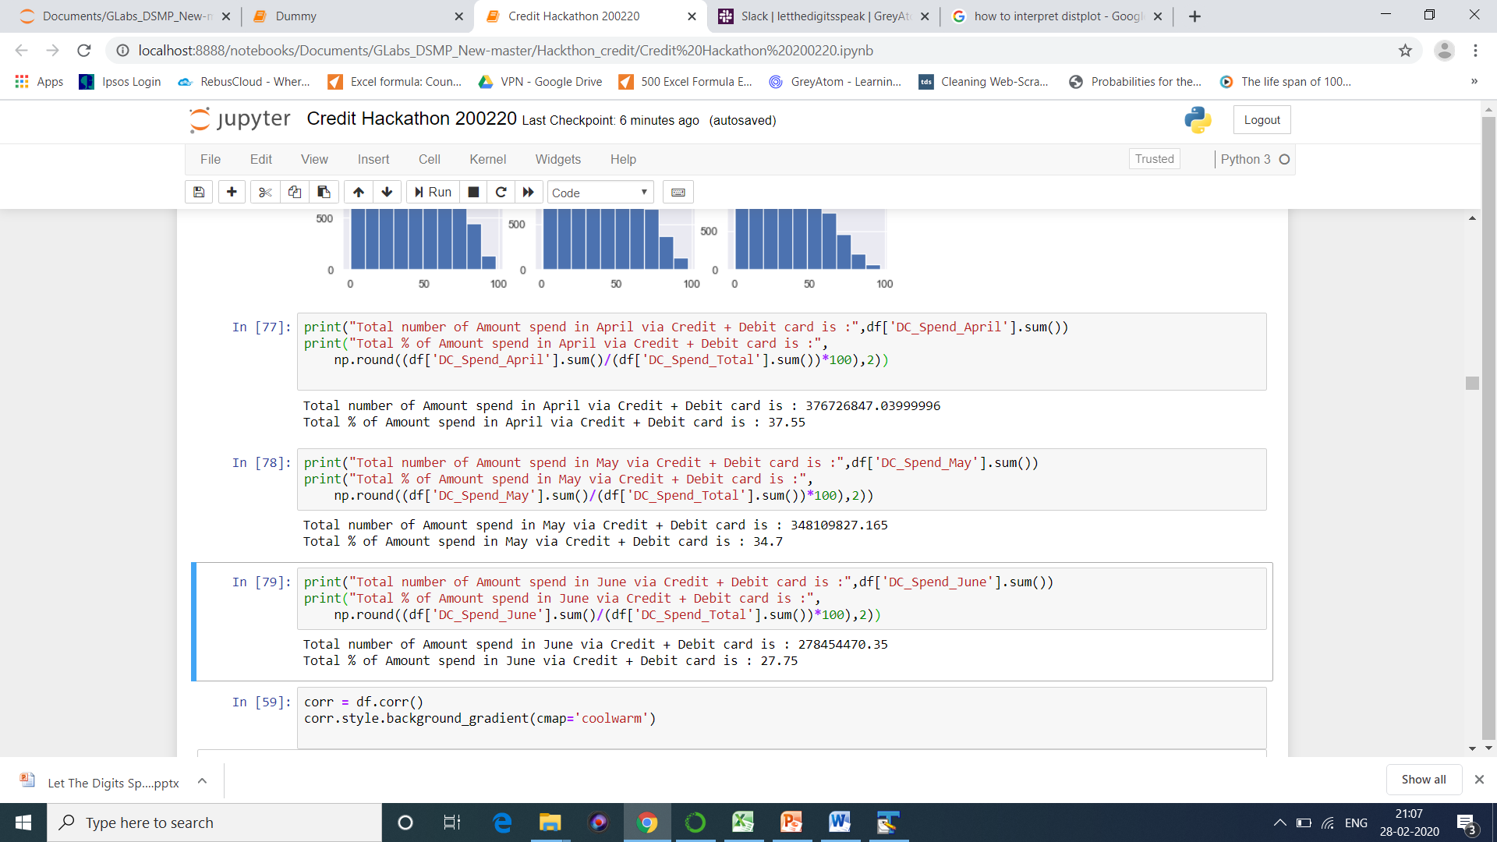
Inference: Almost 38% transaction has been done in the month of April.

Slide 20
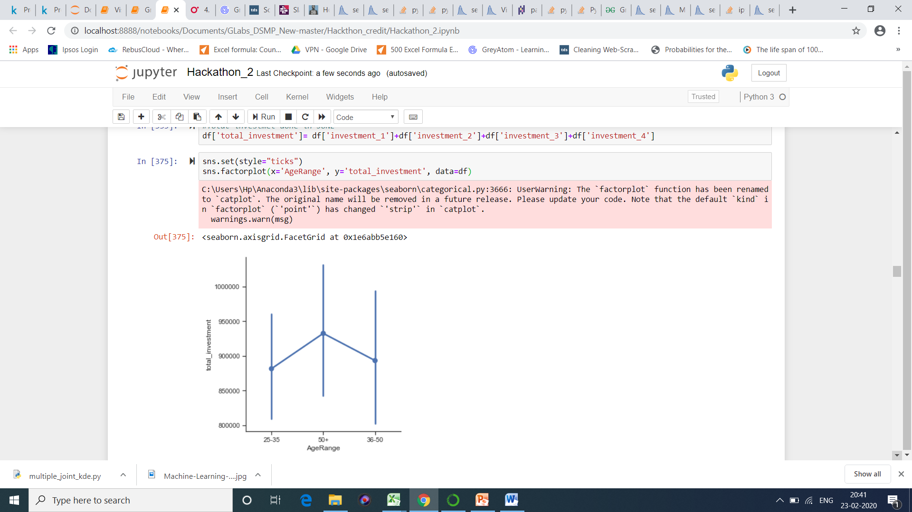
Question 11) How the total investment varies?
Inference: We can clearly observe that most of the investment that too with highest amount is done by people above age 50.

Slide 21
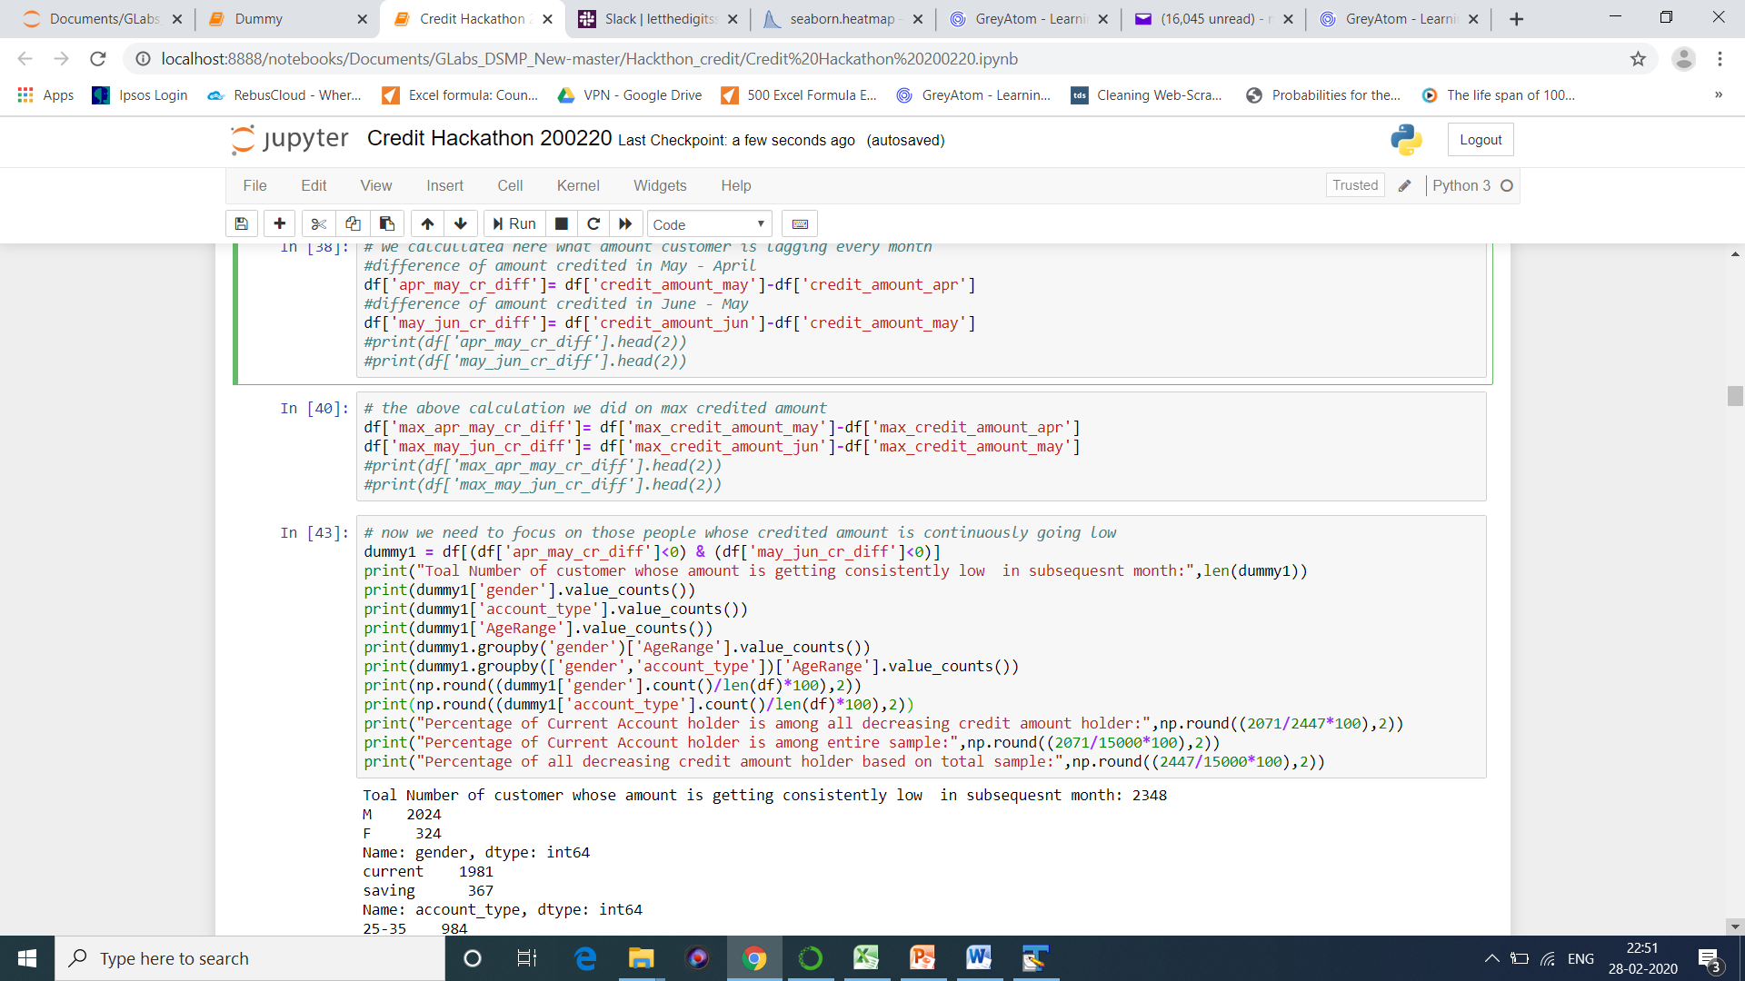
Question 12) Did we observe any specific pattern in credited amount in account per month?

Slide 22
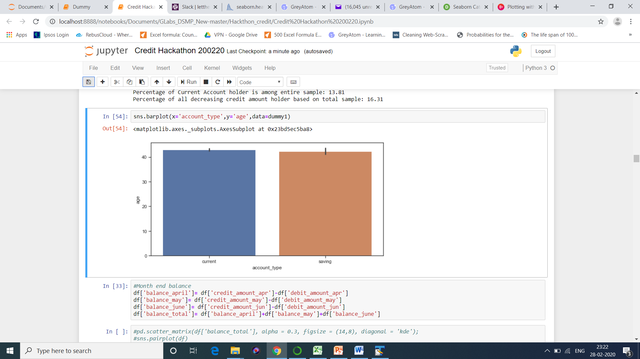
Inference :
Total Number of customer whose amount is getting consistently low in subsequent month: 2348
Male count among the are: 2024
Female count among the are: 324
Current Account Holders among them are: 1981
Current Saving Holders among them are: 367
Most of them belongs to Age group of 36-50
Percentage of Current Account holder is among all decreasing credit amount holder: 84.63
Percentage of Current Account holder is among entire sample: 13.81
Percentage of all decreasing credit amount holder based on total sample: 16.31

Slide 23
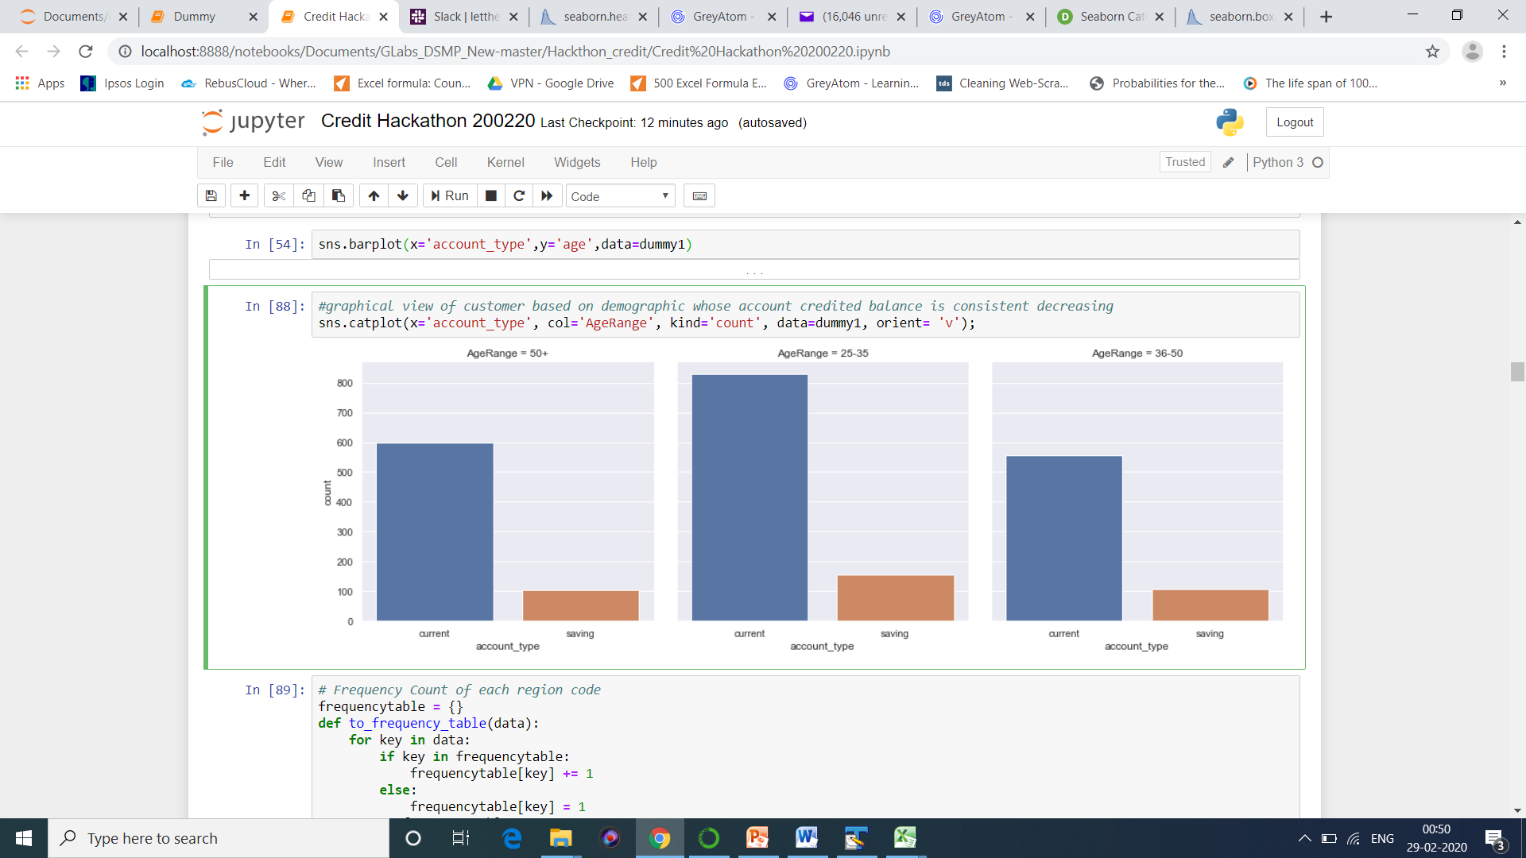
Inference:
1)We can observe that youngsters having Current Account having consistently low balance. They could be a new in their Start-ups.
2) Youngsters having saving account also have low balance consistently and which can accepted.

Slide 24
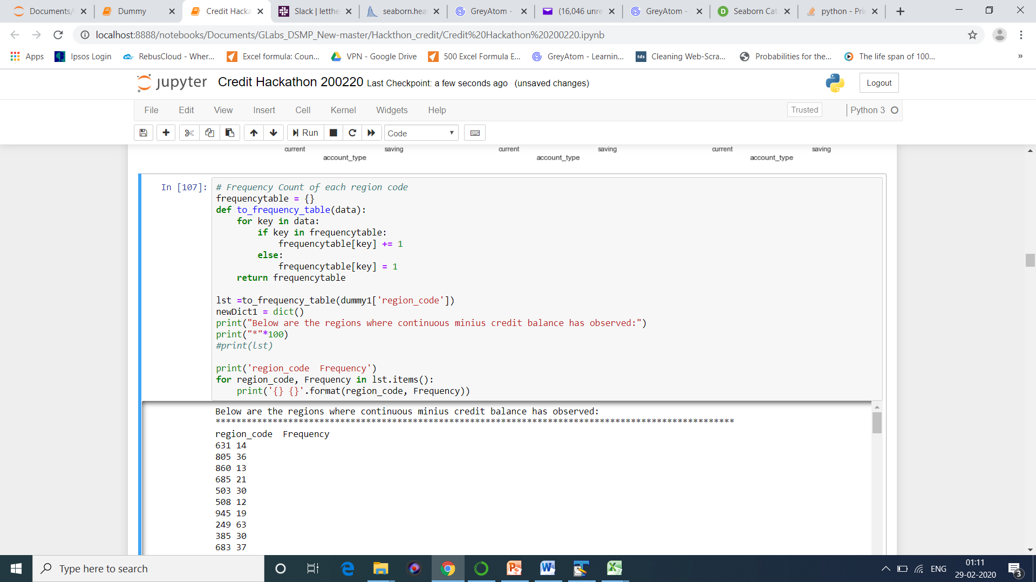
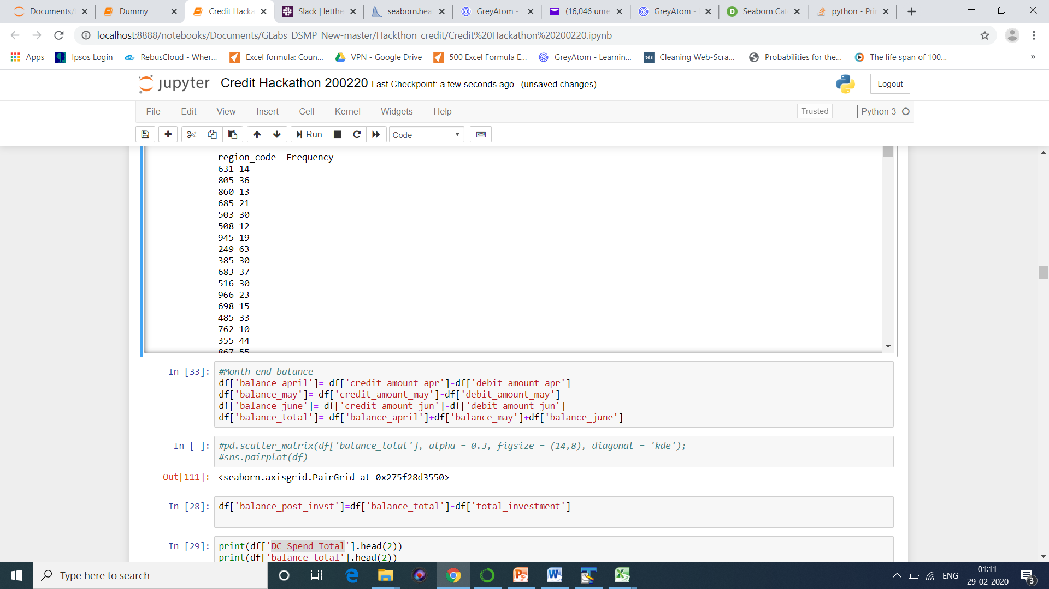
Inference: The mentioned regions are those where balance is low

Slide 25
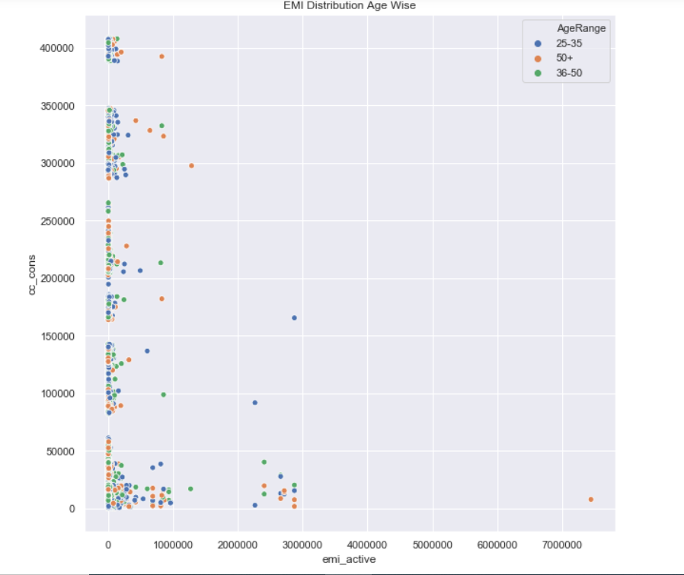
Question 13) Is the Age group matters on EMI?
Readings: We can observe that most of EMI lies between 0-1lakh.

Slide 26
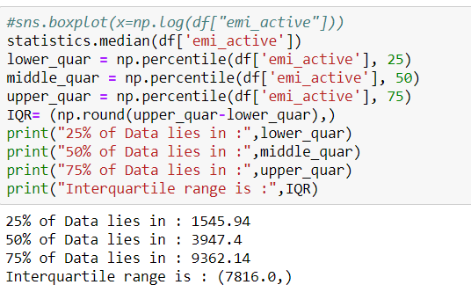

Slide 27
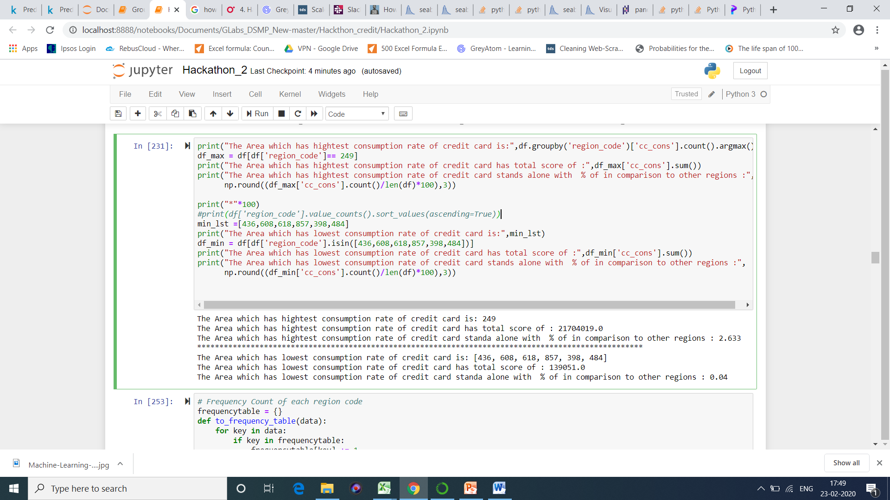
Question 14) Does Area matter in credit card consumption?

Slide 28
Inference:
The Area which has highest consumption rate of credit card is: 249
The Area which has highest consumption rate of credit card has total score of : 2,07,16,937.0
The Area which has highest consumption rate of credit card stands alone with % of in comparison to other regions : 2.6
4) The Area which has lowest consumption rate of credit card is: 436
5) The Area which has lowest consumption rate of credit card has total score of : 2939
6) The Area which has lowest consumption rate of credit card stands alone with % of in comparison to other regions : 0.00037
7) For the given dataset, we have considered the threshold of 2000 average amount for 3 months transaction, so for below mentioned regions banks should implement a strategy to increase their average transaction : [436,484,608,618,857,874].

Slide 29
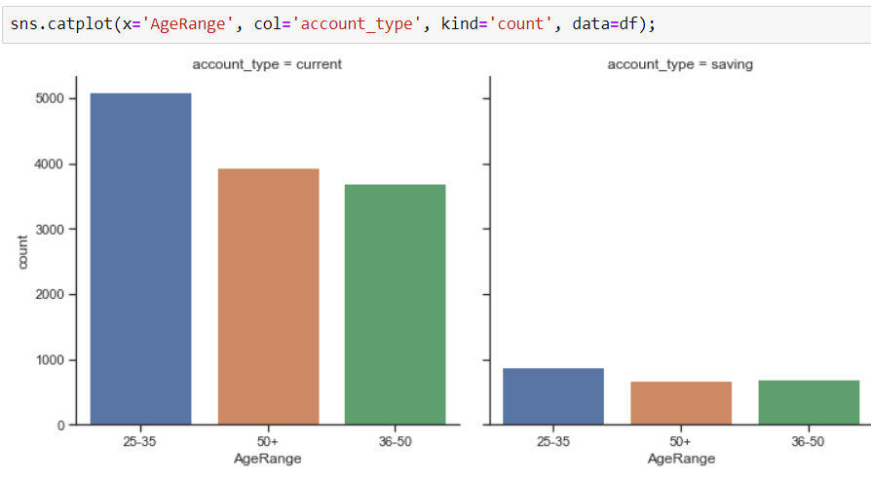
Inference: We can see that based on our previous analysis most of the people who are above 50+ , most of them have current account and hence the investment was more here.

Slide 30
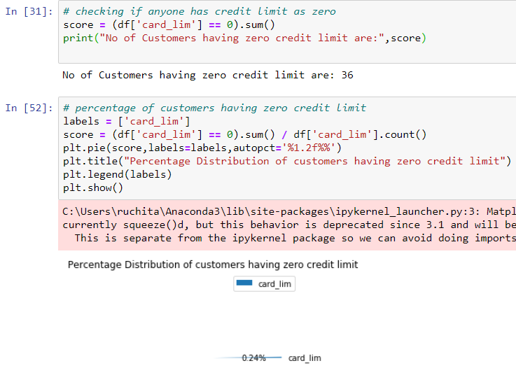
Question 15) What is the numbers of customers having zero credit limit?
Inference: Here we can see 36 customers which is 0.24 % of customers have zero credit limit. This can happen for many reasons such as :
if the payment is not cleared or
the payment is late or
the credit card limit is exhausted.

Slide 31
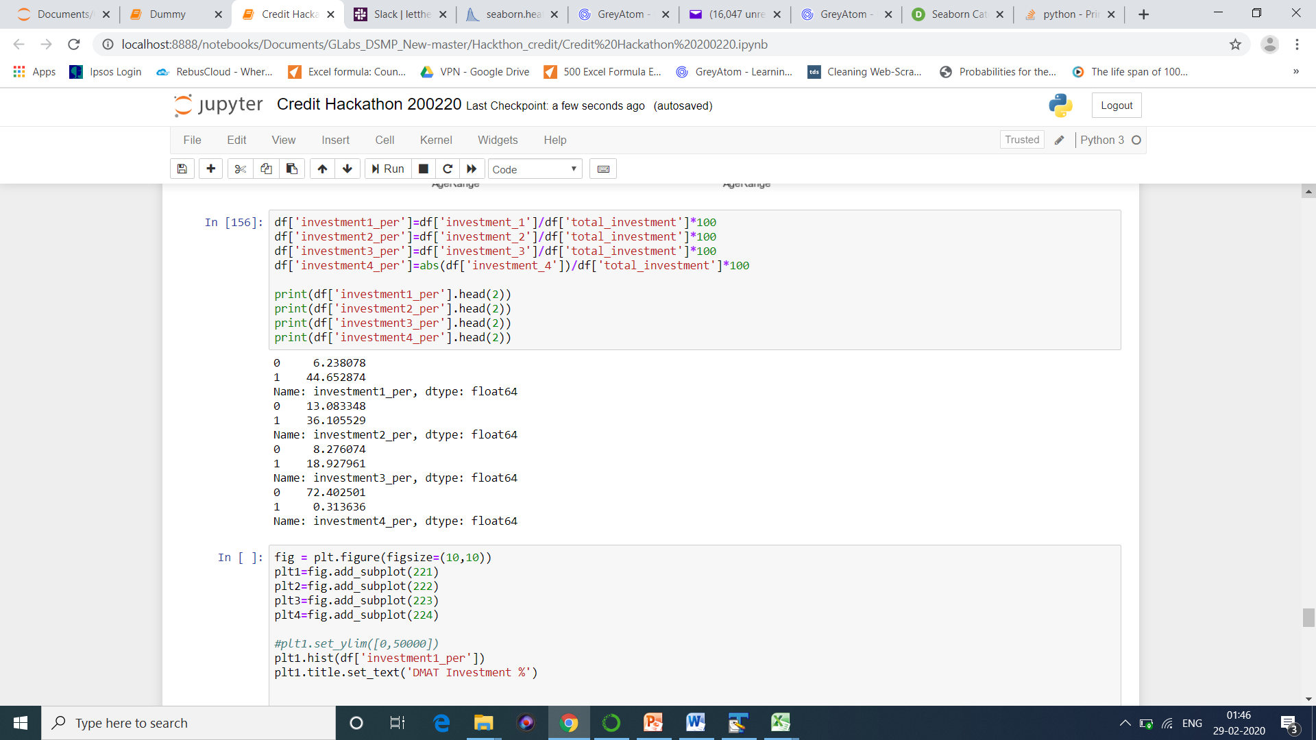
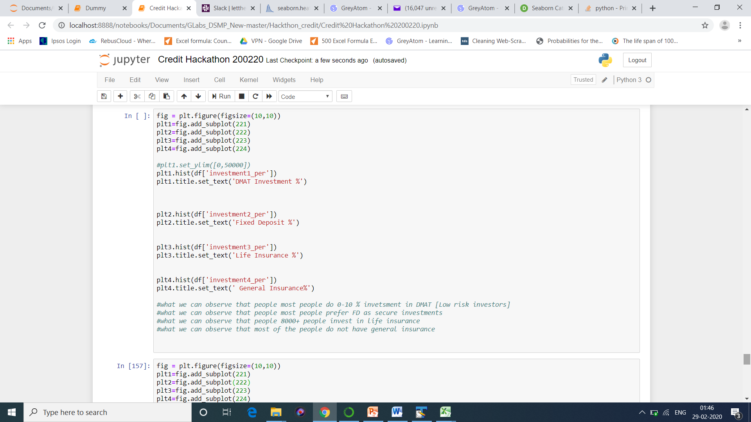
Question 16) What is the flow of Investment ?

Slide 32
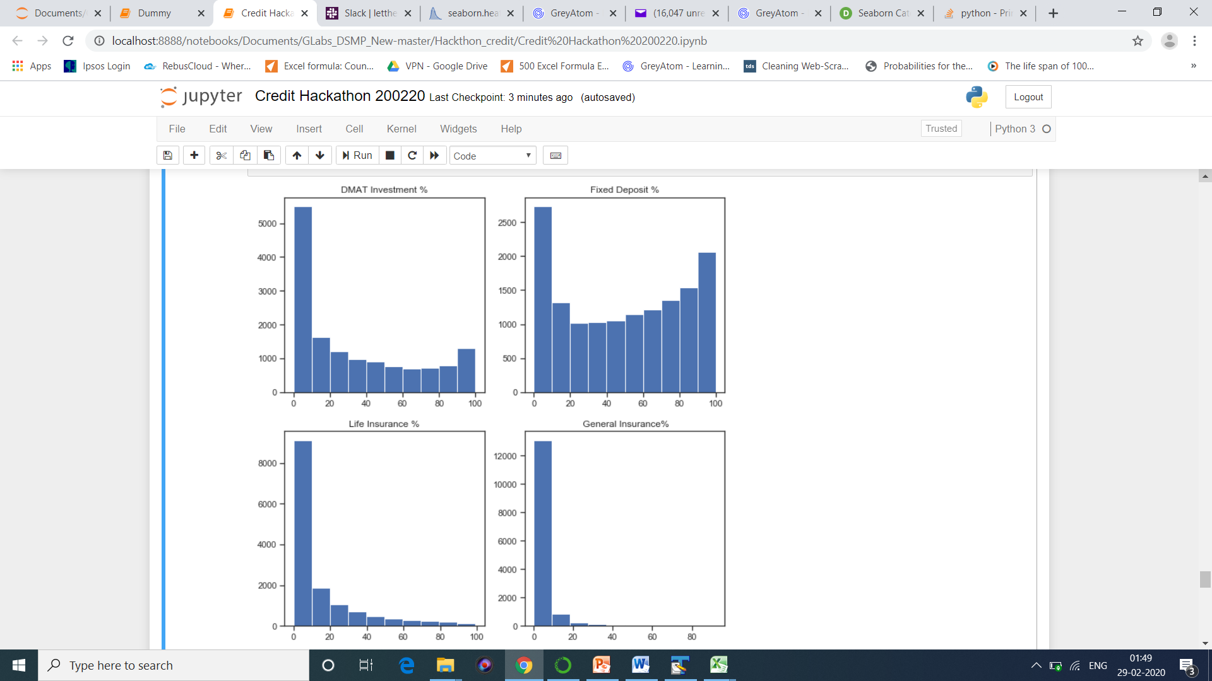
Inference: We can clearly see that people more often go for FD Investment and 2nd preference is given for DMAT.

Slide 33
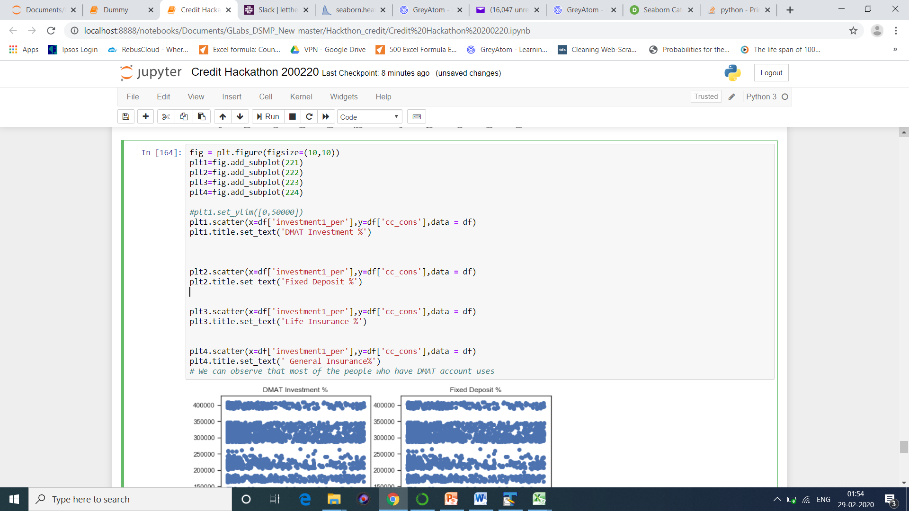

Slide 34
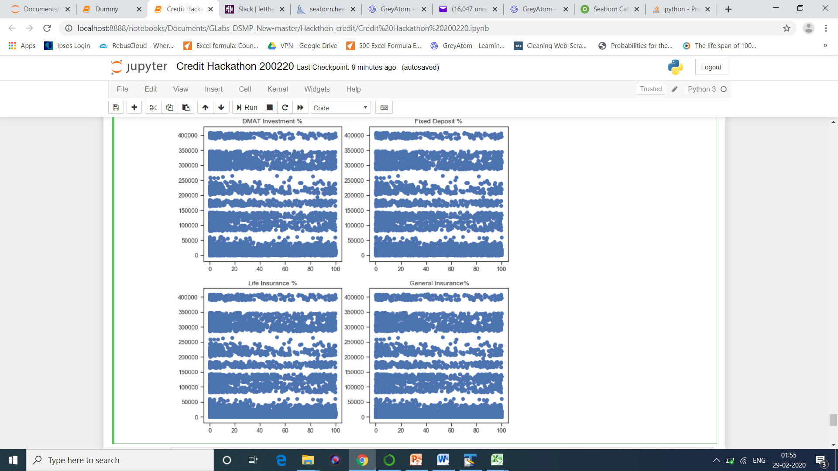

Slide 35
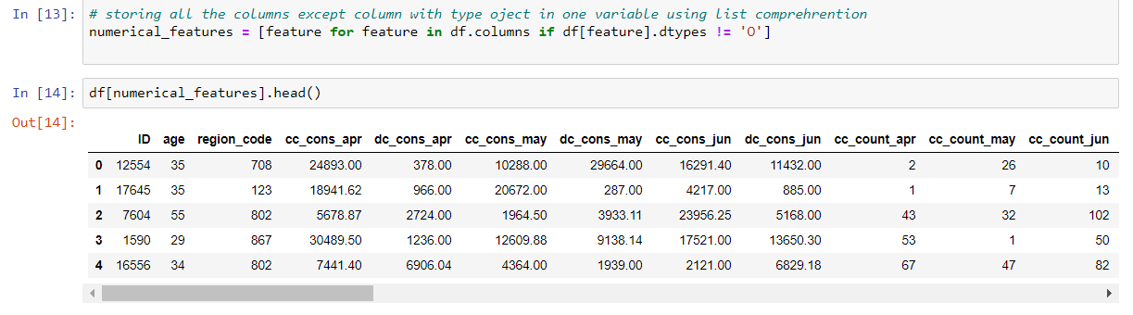
Feature Engineering
Step 1 : Removing the unnecessary columns from the Dataset
Step 2 : Storing all the numerical features except columns with type
object in one variable using list comprehension technique.

Slide 36
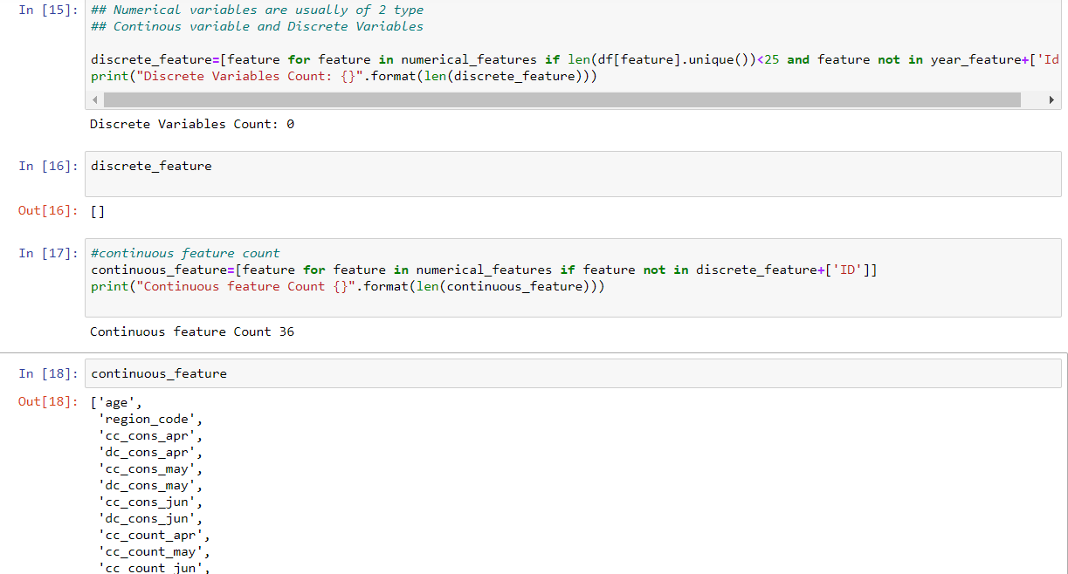
Step 3 : Checking the Number of continuous and discrete features in Numerical features.
Inference : Discrete variable count = 0
Continuous variable count = 36

Slide 37
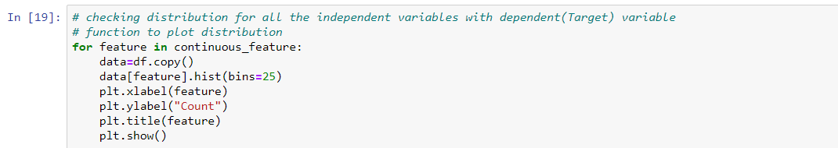
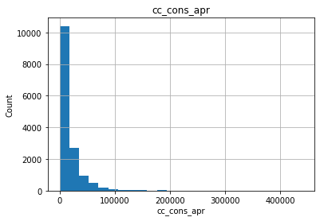
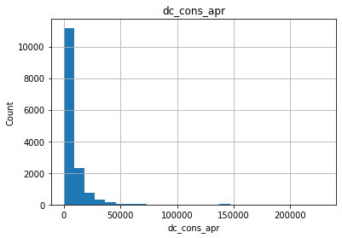
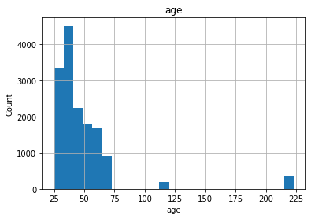
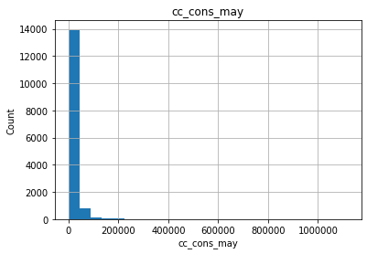
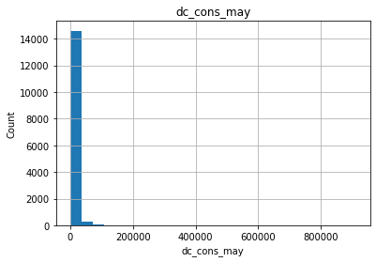
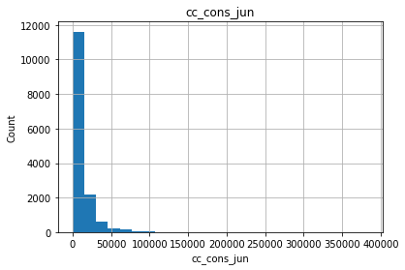
Step 3 : Checking distribution for all the independent variables with dependent(Target) variable
Inference : Here we can see that the data is not normally distributed It is Left Skewed.

Slide 38
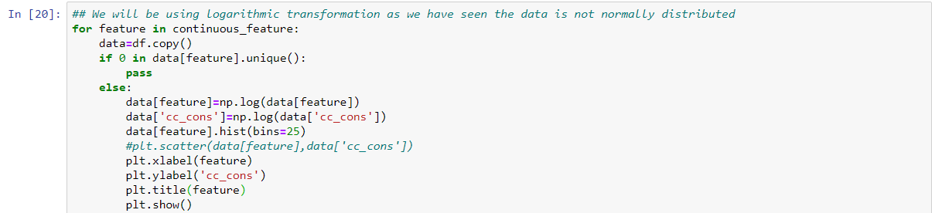
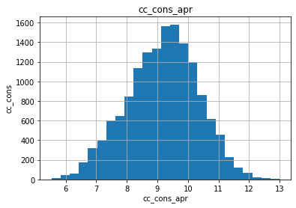
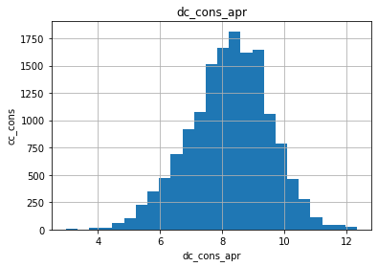
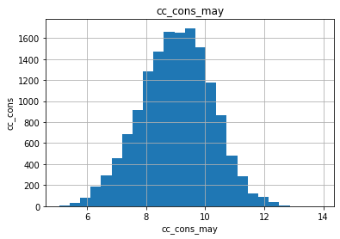
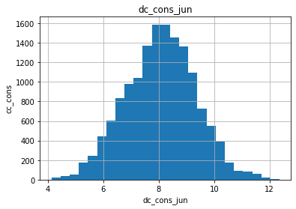
Step 4:In order to make data normally distributed we will be using logarithmic transformation
Inference : After applying Log Transform we can see that the skewness has gone, and the data is showing normal distribution.

Slide 39
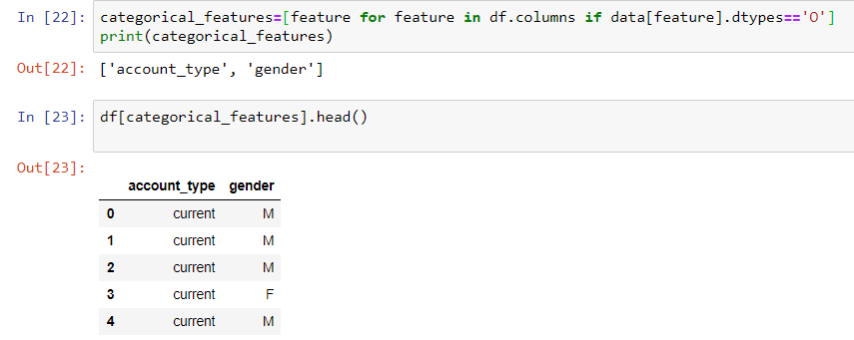
Step 5 : Same as we did for numerical features here we are storing all the categorical features in one variable using list comprehension technique.
Inference : We have got two categorical features in our dataset which are Account type and Gender

Slide 40
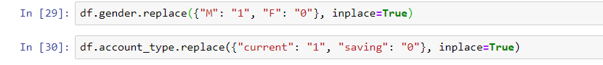
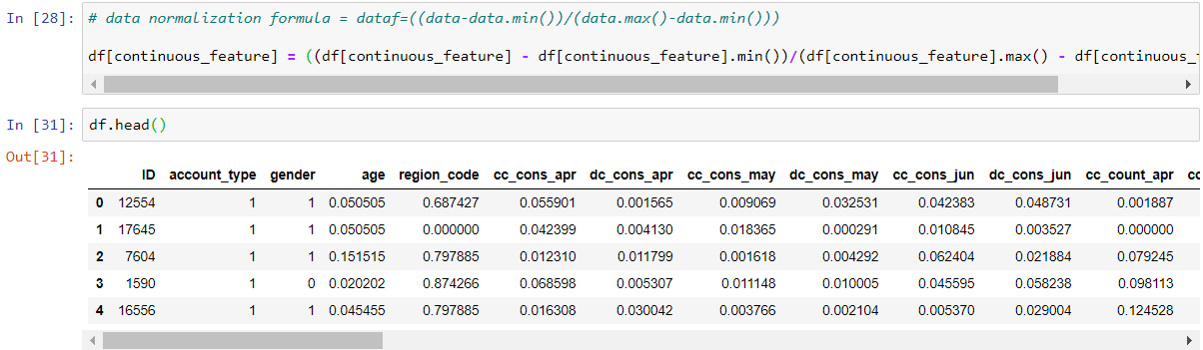
Step 6 : Converting the categorical values to numerical values.
Inference : As there are only two categorical features we are simply replacing the values with 0 & 1. We can also apply one-hot encoding if the number of features are more.
Step 7 : Applying normalization on all continuous features to convert them into a common scale
Inference : Here we can see the normalized values in all the continuous features

Slide 41
CEO Deck
People who Invests more can be targeted by Giving More Discounts as they prefer saving.
Banks can plan some good strategies for the people who’s credit amount getting decreased consistently over the months.
Youngsters having current account seems to be investing more. So here the bank can attract this group by providing lucrative offers so that the will invest more.
We can target customers region wise wherein the transactions were lowest.
As the people tend to invest more in Fix Deposits banks can provide FD plan with highest/attractive interest rates.

